Slide 1
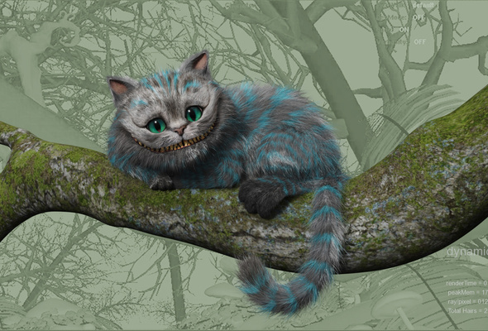
Помоги Чеширскому коту исчезнуть

Slide 3
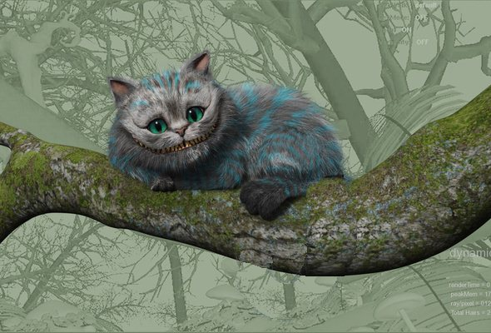

Slide 4
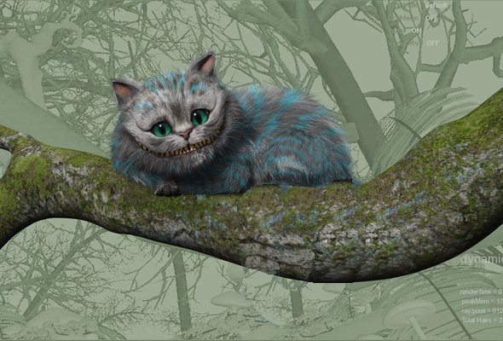

Slide 5
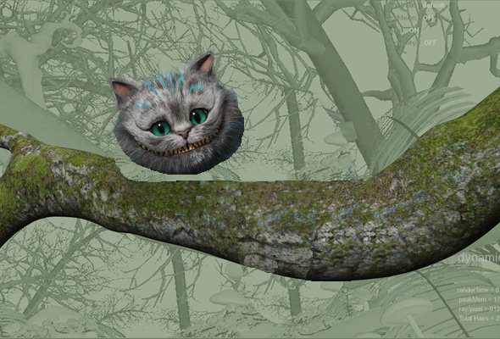
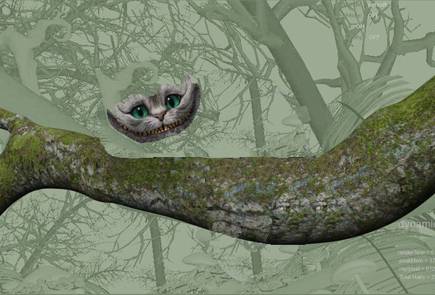

Slide 7
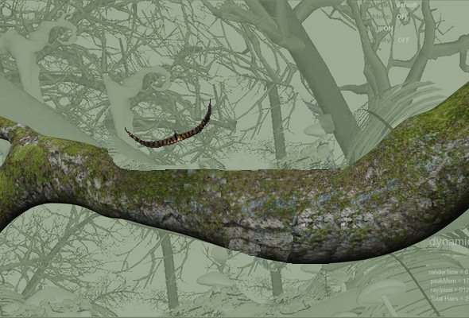

Slide 8
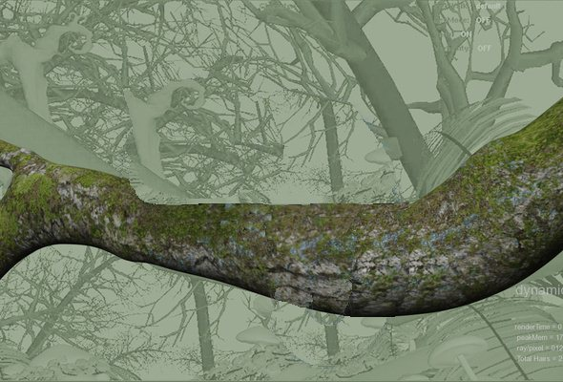
Отлично!

Slide 9

You can use this game to practice any kind of theme. I use it by preparing a list of questions, if the student answer correctly a part of the cat disappears.
The aim is to make the Cheshire Cat completely disappear.

